Slide 1
Covert Channels:
Hiding Data In Plain Sight
Capt Daniel Fitzgerald
23 JUL 2024

Slide 2
Evaluating Covert Channels
Categorize based on patterns
A Pattern-based Survey and Categorization of Network Covert Channel Techniques by Steffen Wendzel, Sebastian Zander, Bernhard Fechner, Christian Herdin [Wendzel 2014]
Whitepaper: https://arxiv.org/pdf/1406.2901.pdf
Author’s website: https://www.wendzel.de/
Current: https://ih-patterns.blogspot.com/p/test.html
History of updates: https://wendzel.de/dr.org/files/Papers/EICC22_poster.pdf
Author’s addresses: S. Wendzel, Fraunhofer Institute for Communication, Information Processing and Ergonomics FKIE, Bonn, Germany; S. Zander, Centre for Advanced Internet Architectures, Swinburne University of Technology, Melbourne, Australia; B. Fechner, University of Augsburg, Department of Systems and Networking, Augsburg, Germany; C. Herdin, University of Rostock, Department of Computer Science, Rostock, Germany Permission to make digital or hard copies of part or all of this work for personal or classroom use is granted without fee provided that copies are not made or distributed for profit or commercial advantage and that copies show this notice on the first page or initial screen of a display along with the full citation. Copyrights for components of this work owned by others than ACM must be honored. Abstracting with credit is permitted. To copy otherwise, to republish, to post on servers, to redistribute to lists, or to use any component of this work in other works requires prior specific permission and/or a fee. Permissions may be requested from Publications Dept., ACM, Inc., 2 Penn Plaza, Suite 701, New York, NY 10121-0701 USA, fax +1 (212) 869-0481, or permissions@acm.org. c 2014 ACM 0360-0300/2014/-ART1 $15.00 DOI:http://dx.doi.org/10.1145/0000000.0000000
Notes:
https://www.wendzel.de/
https://ih-patterns.blogspot.com/p/test.html
[1] S. Wendzel, S. Zander, B. Fechner, C. Herdin: Pattern-based Survey and Categorization of Network Covert Channel Techniques, ACM Computing Surveys, Vol. 47, Issue 3, pp. 50:1-26, ACM, 2015. An early version of the article is available here: download. [2] W. Mazurczyk, S. Wendzel, S. Zander, A. Houmansadr, K. Szczypiorski: Information Hiding in Communication Networks, Wiley, 2016. Chapters 3 and 8 contain discussions on hiding patterns, basically on the basis of [1] but with an extension of timing-based patterns. [3] W. Mazurczyk, S. Wendzel, K. Cabaj: Towards Deriving Insights into Data Hiding Methods Using Pattern-based Approach, in Proc. Second International Workshop on Criminal Use of Information Hiding (CUING 2018) at ARES, pp. 10:1-10:10, ACM, 2018.
[4] A. Velinov, A. Mileva, S. Wendzel, W. Mazurczyk: Covert Channels in MQTT-based Internet of Things, IEEE ACCESS, Vol. 7, pp. 161899-161915, 2019.
[5] A. Mileva, A. Velinov, L. Hartmann, S. Wendzel, W. Mazurczyk: Comprehensive Analysis of MQTT 5.0 Susceptibility to Network Covert Channels, Computers & Security, Elsevier, 2021.
[6] L. Hartmann, S. Zillien, S. Wendzel: Reset- and Reconnection-based Covert Channels in CoAP. In: Proc. European Interdisciplinary Cybersecurity Conference (EICC), 2021.

Slide 3
Evaluating Covert Channels
Video Introduction to Patterns: https://www.youtube.com/watch?v=0ztPHur0LUY
Notes:
https://www.wendzel.de/
https://ih-patterns.blogspot.com/p/test.html
[1] S. Wendzel, S. Zander, B. Fechner, C. Herdin: Pattern-based Survey and Categorization of Network Covert Channel Techniques, ACM Computing Surveys, Vol. 47, Issue 3, pp. 50:1-26, ACM, 2015. An early version of the article is available here: download. [2] W. Mazurczyk, S. Wendzel, S. Zander, A. Houmansadr, K. Szczypiorski: Information Hiding in Communication Networks, Wiley, 2016. Chapters 3 and 8 contain discussions on hiding patterns, basically on the basis of [1] but with an extension of timing-based patterns. [3] W. Mazurczyk, S. Wendzel, K. Cabaj: Towards Deriving Insights into Data Hiding Methods Using Pattern-based Approach, in Proc. Second International Workshop on Criminal Use of Information Hiding (CUING 2018) at ARES, pp. 10:1-10:10, ACM, 2018.
[4] A. Velinov, A. Mileva, S. Wendzel, W. Mazurczyk: Covert Channels in MQTT-based Internet of Things, IEEE ACCESS, Vol. 7, pp. 161899-161915, 2019.
[5] A. Mileva, A. Velinov, L. Hartmann, S. Wendzel, W. Mazurczyk: Comprehensive Analysis of MQTT 5.0 Susceptibility to Network Covert Channels, Computers & Security, Elsevier, 2021.
[6] L. Hartmann, S. Zillien, S. Wendzel: Reset- and Reconnection-based Covert Channels in CoAP. In: Proc. European Interdisciplinary Cybersecurity Conference (EICC), 2021.

Slide 4
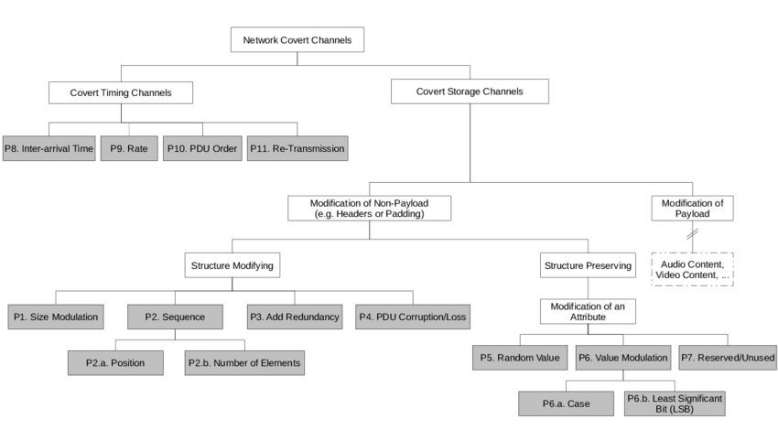
Original as of 2015
Evaluating Covert Channels
[Wendzel 2015]
Notes:
[1] S. Wendzel, S. Zander, B. Fechner, C. Herdin: Pattern-based Survey and Categorization of Network Covert Channel Techniques, ACM Computing Surveys, Vol. 47, Issue 3, pp. 50:1-26, ACM, 2015. An early version of the article is available here: download.

Slide 5
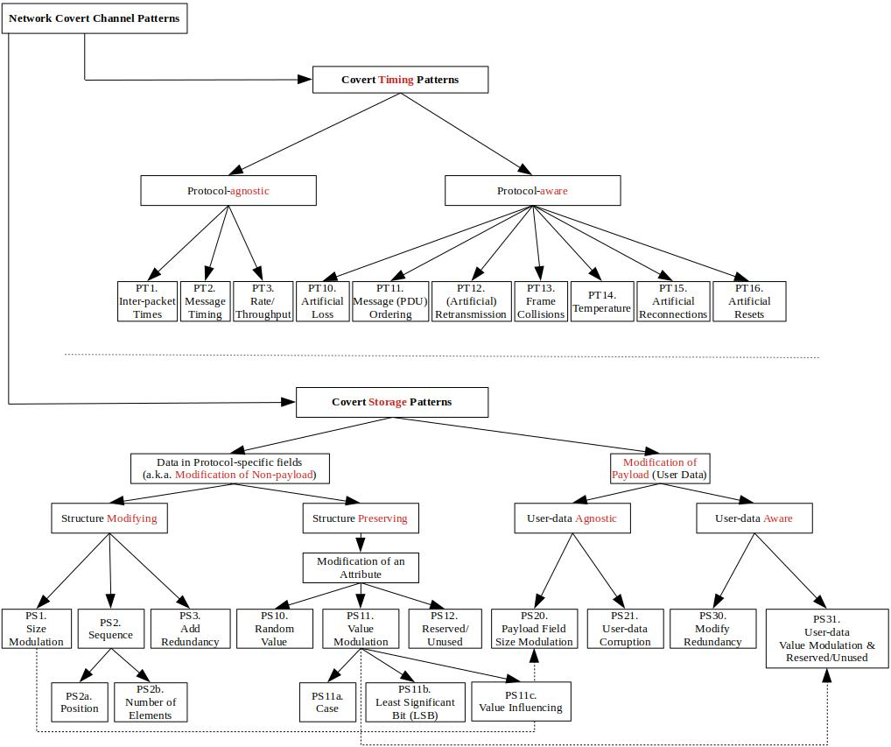
Updated as of 25 Mar 2022
[https://ih-patterns.blogspot.com/p/test.html]
Notes:
[1] S. Wendzel, S. Zander, B. Fechner, C. Herdin: Pattern-based Survey and Categorization of Network Covert Channel Techniques, ACM Computing Surveys, Vol. 47, Issue 3, pp. 50:1-26, ACM, 2015. An early version of the article is available here: download. [2] W. Mazurczyk, S. Wendzel, S. Zander, A. Houmansadr, K. Szczypiorski: Information Hiding in Communication Networks, Wiley, 2016. Chapters 3 and 8 contain discussions on hiding patterns, basically on the basis of [1] but with an extension of timing-based patterns. [3] W. Mazurczyk, S. Wendzel, K. Cabaj: Towards Deriving Insights into Data Hiding Methods Using Pattern-based Approach, in Proc. Second International Workshop on Criminal Use of Information Hiding (CUING 2018) at ARES, pp. 10:1-10:10, ACM, 2018.
[4] A. Velinov, A. Mileva, S. Wendzel, W. Mazurczyk: Covert Channels in MQTT-based Internet of Things, IEEE ACCESS, Vol. 7, pp. 161899-161915, 2019.
[5] A. Mileva, A. Velinov, L. Hartmann, S. Wendzel, W. Mazurczyk: Comprehensive Analysis of MQTT 5.0 Susceptibility to Network Covert Channels, Computers & Security, Elsevier, 2021.
[6] L. Hartmann, S. Zillien, S. Wendzel: Reset- and Reconnection-based Covert Channels in CoAP. In: Proc. European Interdisciplinary Cybersecurity Conference (EICC), 2021.

Slide 6
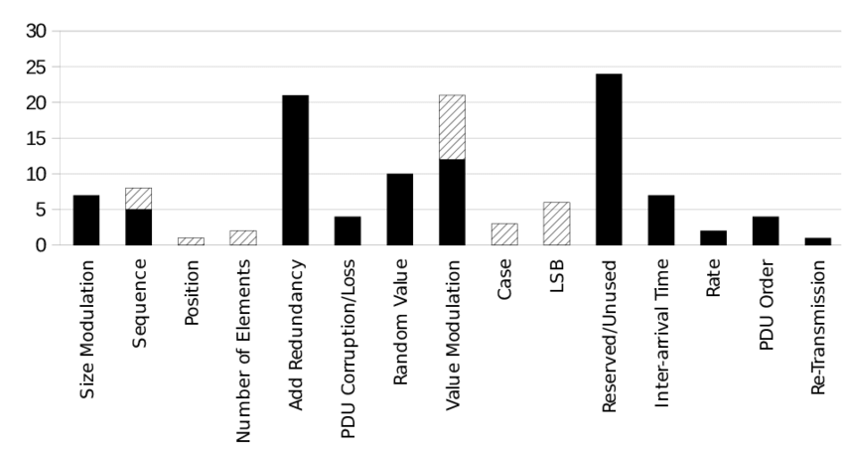
Evaluating Covert Channels
109 covert channels analyzed fit into 11 different patterns
69.7% can be categorized into only 4 different patterns
[Wendzel 2014]
Notes:
Screenshot from A Pattern-based Survey and Categorization of Network Covert Channel Techniques by Steffen Wendzel
https://arxiv.org/pdf/1406.2901.pdf
[1] S. Wendzel, S. Zander, B. Fechner, C. Herdin: Pattern-based Survey and Categorization of Network Covert Channel Techniques, ACM Computing Surveys, Vol. 47, Issue 3, pp. 50:1-26, ACM, 2015. An early version of the article is available here: download.

Slide 7
Evaluating Covert Channels
PS1. Size Modulation Pattern
Illustration: Uses size of a header element or PDU to encode message
Context: Storage -> Modification of Non-Payload -> Structure Modifying
Evidence:
Data block length in LAN frames
Padding field’s size in 802.3 frames
Message length of network packets
Size of IPSec messages
IP fragment sizes

Slide 8
Evaluating Covert Channels
PS2. Sequence Pattern
Illustration: Alters the sequence of header/PDU elements to encode message
Context: Storage -> Modification of Non-Payload -> Structure Modifying
Evidence:
Sequence of HTTP header fields
Sequence of DHCP options
Sequence of FTP commands

Slide 9
Evaluating Covert Channels
PS2.a. Position Pattern
Illustration: Alters position of a given header/PDU element
Context: Storage -> Non-Payload -> Structure Modifying -> Sequence
Evidence:
Position of IPv4 option in options list
Position of IPv6 extension header in extension header list
PS2.b. Number of Elements Pattern
Illustration: The number of header/PDU elements transferred
Context: Storage -> Non-Payload -> Structure Modifying -> Sequence
Evidence:
Number of options placed in an IPv4 packet
Modulate number of fragments created from an original IP packet
Modulate number of options placed in a DHCP packet

Slide 10
Evaluating Covert Channels
PS3. Add Redundancy Pattern*
Illustration: Creates new space within a given header element/PDU
Context: Storage -> Non-Payload -> Structure Modifying
Evidence:
Generate packets with IPv4 options
Create new IPv6 destination option
Extend HTTP headers with additional fields
Manipulate pointer and length values for IPv4 record route option
Add random bytes to an encrypted SSH message
Extend SMTP packet headers with additional fields
Hide data in unused bits of the DHCP chaddr field
Encapsulate IP packet with smaller size than specified in Ethernet frame

Slide 11
Evaluating Covert Channels
PS10. Random Value Pattern*
Illustration: Embed data in header element containing “random” value
Context: Storage -> Non-Payload -> Structure Preserving -> Modification of an Attribute
Evidence:
IPv4 Identifier field
First sequence number of a TCP connection (ISN)
TCP ISN using a bounce server
DHCP xid field
SSH MAC field

Slide 12
Evaluating Covert Channels
PS11. Value Modulation Pattern*
Illustration: Channel selects one of n values a header element can contain
Context: Storage -> Non-Payload -> Structure Preserving -> Modification of an Attribute
Evidence:
Send frame to one of n available addresses in local network
Encode info by n of the possible IP header TTL values
Encode info by n of possible Hop Limit values in IPv6 header
Encode info by sending packet using one of n possible application layer protocols
Encode info in the target IP of ARP messages
Send IPSec packets from one VPN site to specific destination IPs within another VPN site

Slide 13
Evaluating Covert Channels
PS11.a. Case Pattern
Illustration: Case-modification of letters in header elements
Context: Storage->Non-Payload->Structure Preserving->Modification of Attribute-> Value Modulation
Evidence:
Case modification in HTTP headers or SMTP/POP3/etc. commands and headers
PS11.b. Least Significant Bit (LSB) Pattern
Illustration: Uses LSB of header elements
Context: Storage->Non-Payload->Structure Preserving->Modification of Attribute-> Value Modulation
Evidence:
IPv4 timestamp option by sending at even/odd times
Use LSB of IPv4 TTL or IPv6 Hop Limit or Hop Count field of BACnet protocol

Slide 14
Evaluating Covert Channels
PS11.c. Value Influencing Pattern
Illustration: Sender (directly or indirectly) influences some (out of n possible) values in a way that a covert channel receiver can determine the value
Context: Storage->Non-Payload->Structure Preserving->Modification of Attribute-> Value Modulation
Evidence:
A. Velinov, A. Mileva, S. Wendzel, W. Mazurczyk: Covert Channels in MQTT-based Internet of Things, IEEE ACCESS, Vol. 7, pp. 161899-161915, 2019

Slide 15
Evaluating Covert Channels
PS12. Reserved/Unused Pattern*
Illustration: Encode data into reserved or unused header/PDU element
Context: Storage->Non-Payload->Structure Preserving->Modification of an Attribute
Evidence:
Unused fields in IPv4, e.g. ID field, DF flag, Reserved flag
Unused fields in IPv6 header or extension headers
ICMP echo payload
Unused fields in BACnet header
Place data behind string termination symbol of sname/file DHCP fields
DS field of outbound IPSec connections
ECN field in IPSec connections

Slide 16
Evaluating Covert Channels
PS20. Payload Field Size Modulation
Illustration: Uses a size of the payload field of a flow's PDUs/messages to encode the hidden message. Variant of Size Modulation.
Context: Storage->Payload->User-data Agnostic
Evidence:
Modulate size of data block field in Ethernet frames
Any other method that modulates size of payload field in any network protocol

Slide 17
Evaluating Covert Channels
PS21. User-data Corruption
Illustration: Related to the cases when steganographic methods do not take into account what kind of user-data is carried within a payload field and/or what its characteristic is (blind modification). It can be applied to single PDUs or to multiple PDUs (a flow). This typically happens if parts of (or the whole) user-data is replaced with secret bits and thus the user-data is corrupted/lost.
Context: Storage->Payload->User-data Agnostic
Evidence:
W. Mazurczyk, S. Wendzel, K. Cabaj: Towards Deriving Insights into Data Hiding Methods Using Pattern-based Approach, in Proc. Second International Workshop on Criminal Use of Information Hiding (CUING 2018) at ARES, pp. 10:1-10:10, ACM, 2018.

Slide 18
Evaluating Covert Channels
PS30. Modify Redundancy
Illustration: Used when it is possible to exploit the redundancy of the user-data by means of transforming them in such a way that a free space for secret data is obtained. Similar to Add Redundancy but can also decrease redundancy and is applied to payload instead of meta-data.
Context: Storage->Payload->User-data Aware
Evidence:
Compress existing user-data in order to make a space for secret data.
Transform the VAD-enabled IP telephony voice stream into non-VAD one and fill the gaps using artificially generated RTP packets containing secret data.
Approximate the F0 parameter of the Speex codec which carries information about the pitch of the speech signal and use the ``saved'' space for secret data.

Slide 19
Evaluating Covert Channels
PS31. User-data Value Modulation and Reserved/Unused
Illustration: Characteristic features of user-data can be utilized to store secret information. This includes applying methods like LSB modification to speech samples or digital images carried within the payload field. Compared with previous patterns this is a targeted modification. This pattern is analogous to the combination of the patterns.
Context: Storage->Payload->User-data Aware
Evidence:
Encode a stream of information by spreading the encoded data across as much of the frequency spectrum as feasible (e.g. DSSS).
Embeds secret data into a carrier audio signal by introducing an echo (a.k.a. echo hiding).
Replacing the least significant bit of e.g. each voice sample with secret data (LSB).

Slide 20
Evaluating Covert Channels
PT1. Inter-packet Times
Illustration: Alters timing intervals between network PDUs (inter-arrival times)
Context: Timing Channels->Protocol-agnostic
Evidence:
Timings between LAN frames sent
Response time of HTTP server
Timings between BACnet/IP packets
Introduce artificial delays into inter-arrival times of SSH packets
Record legitimate traffic sequence, partition sequence and replay the inter-arrival times of a particular partition

Slide 21
Evaluating Covert Channels
PT2. Message Sequence Timing
Illustration: Hidden data is encoded in the timing of message sequences, e.g. acknowledging every n'th received packet or sending commands m times.
Context: Timing Channels->Protocol-agnostic
Evidence:
W. Mazurczyk, S. Wendzel, S. Zander, A. Houmansadr, K. Szczypiorski: Information Hiding in Communication Networks, Wiley, 2016. Chapters 3 and 8 contain discussions on hiding patterns, basically on the basis of [1] but with an extension of timing-based patterns.

Slide 22
Evaluating Covert Channels
PT3. Rate/Throughput Pattern
Illustration: Sender alters data rate of traffic flow from self or 3rd party
Context: Timing Channels->Protocol-agnostic
Evidence:
Exhaust performance of a switch to affect the throughput of 3rd party connection
Manipulate serial communication port’s throughput by delaying Clear to Send/Read to Send commands
Directly alter data rate of legitimate channel

Slide 23
Evaluating Covert Channels
PT10. Artificial Message/Packet Loss Pattern
Illustration: Hidden information via artificial loss of transmitted messages (PDUs)
Context: Timing Channels->Protocol-aware
Evidence:
W. Mazurczyk, S. Wendzel, S. Zander, A. Houmansadr, K. Szczypiorski: Information Hiding in Communication Networks, Wiley, 2016. Chapters 3 and 8 contain discussions on hiding patterns, basically on the basis of [1] but with an extension of timing-based patterns.

Slide 24
Evaluating Covert Channels
PT11. Message Ordering Pattern
Illustration: Encode data using synthetic PDU order for given number of PDUs flowing between sender and receiver
Context: Timing Channels->Protocol-aware
Evidence:
Modify order of IPSec Authentication Header (AH) packets
Modify order of IPSec ESP packets
Modify order of TCP packets
Modify order of IPSec packets for inbound/outbound VPN traffic
Sender transfers frames in a way they are send before or after a legitimate user’s frames in CSMA/CD networks

Slide 25
Evaluating Covert Channels
PT12. Re-Transmission Pattern
Illustration: Channel re-transmits previously send/received PDUs
Context: Timing Channels->Protocol-aware
Evidence:
Transfer selected DNS requests once/twice to encode bit per request
Duplicate 802.11 packets
Re-transmit selected TCP segments
Do not ACK received packets in order to force sender to re-transmit

Slide 26
Evaluating Covert Channels
PT13. Frame Collision Pattern
Illustration: Sender causes artificial frame collisions to signal hidden information.
Context: Timing Channels->Protocol-aware
Evidence:
W. Mazurczyk, S. Wendzel, S. Zander, A. Houmansadr, K. Szczypiorski: Information Hiding in Communication Networks, Wiley, 2016. Chapters 3 and 8 contain discussions on hiding patterns, basically on the basis of [1] but with an extension of timing-based patterns.
Notes:
Generate corrupted messages in broadcast erasure channels
Transfer corrupted frames in 802.11
MitM adversary between 2 VPN sites drops selected packets exchanged

Slide 27
Evaluating Covert Channels
PT14. Temperature Pattern
Illustration: Sender influences a third-party node's CPU temperature, e.g.\ using burst traffic. This influences the node's clock skew. The clock skew can then be interpreted by the covert receiver by interacting with the node.
Context: Timing Channels->Protocol-aware
Evidence:
W. Mazurczyk, S. Wendzel, S. Zander, A. Houmansadr, K. Szczypiorski: Information Hiding in Communication Networks, Wiley, 2016. Chapters 3 and 8 contain discussions on hiding patterns, basically on the basis of [1] but with an extension of timing-based patterns.

Slide 28
Evaluating Covert Channels
PT15. Artificial Reconnections
Illustration: Employs artificial (forced) reconnections to transfer secret messages. The covert sender influences connection states of third-party nodes in a way that their connections to either a central element or a peer are terminated and then established again (i.e., a reconnect is performed).
Context: Timing Channels->Protocol-aware
Evidence:
Aleksandra Mileva, Aleksandar Velinov, Laura Hartmann, Steffen Wendzel, Wojciech Mazurczyk: Comprehensive Analysis of MQTT 5.0 Susceptibility to Network Covert Channels, Computers & Security, Elsevier, 2021.
Sebastian Zillien, Steffen Wendzel: Reconnection-based Covert Channels in Wireless Networks. In: Proc. 36th IFIP TC-11 International Information Security and Privacy Conference (IFIP SEC 2021). Springer, 2021.

Slide 29
Evaluating Covert Channels
PT16. Artificial Resets
Illustration: Covert sender causes a connection reset of third-party nodes, whose connection states are observed by one or more covert recievers.
Context: Timing Channels->Protocol-aware
Evidence:
Laura Hartmann, Sebastian Zillien, Steffen Wendzel: Reset- and Reconnection-based Covert Channels in CoAP. In: Proc. European Interdisciplinary Cybersecurity Conference (EICC 2021). ACM, DOI: 10.1145/3487405.3487660
Notes:
https://github.com/NIoSaT/CoAP-Covert-Channels features the first known implementation and is based on the IoT protocol CoAP.

Slide 30
Updated as of 25 Mar 2022
[https://ih-patterns.blogspot.com/p/test.html]
Notes:
[1] S. Wendzel, S. Zander, B. Fechner, C. Herdin: Pattern-based Survey and Categorization of Network Covert Channel Techniques, ACM Computing Surveys, Vol. 47, Issue 3, pp. 50:1-26, ACM, 2015. An early version of the article is available here: download. [2] W. Mazurczyk, S. Wendzel, S. Zander, A. Houmansadr, K. Szczypiorski: Information Hiding in Communication Networks, Wiley, 2016. Chapters 3 and 8 contain discussions on hiding patterns, basically on the basis of [1] but with an extension of timing-based patterns. [3] W. Mazurczyk, S. Wendzel, K. Cabaj: Towards Deriving Insights into Data Hiding Methods Using Pattern-based Approach, in Proc. Second International Workshop on Criminal Use of Information Hiding (CUING 2018) at ARES, pp. 10:1-10:10, ACM, 2018.
[4] A. Velinov, A. Mileva, S. Wendzel, W. Mazurczyk: Covert Channels in MQTT-based Internet of Things, IEEE ACCESS, Vol. 7, pp. 161899-161915, 2019.
[5] A. Mileva, A. Velinov, L. Hartmann, S. Wendzel, W. Mazurczyk: Comprehensive Analysis of MQTT 5.0 Susceptibility to Network Covert Channels, Computers & Security, Elsevier, 2021.
[6] L. Hartmann, S. Zillien, S. Wendzel: Reset- and Reconnection-based Covert Channels in CoAP. In: Proc. European Interdisciplinary Cybersecurity Conference (EICC), 2021.

Slide 31
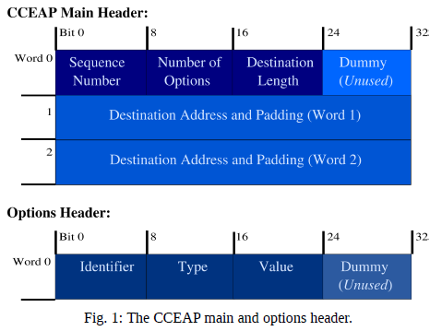
Evaluating Covert Channels
[Wendzel 2014]

Slide 32
Practice Evaluating/Categorizing
CCEAP PCAPs
Previous Practice Problems

Slide 33
Detection
Firewalls – Packet vs Stateful vs Application
Intrusion Detection System – Automate analysis and alert
Intrusion Prevention System – Automate, alert, block
SNORT/NIDS
Moloch – Analysis tool
Endgame???
Security Onion – Blue team security OS
Signatures vs Heuristic vs Patterns
Notes:
Why is detection extremely difficult? – Everything can be used for good and bad.
Only way to determine intent is after the fact.

Slide 34
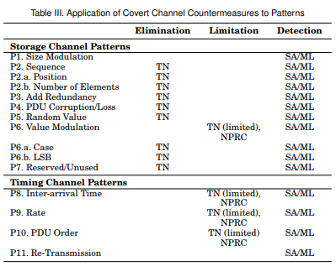
Detection
Detect vs Limit vs Eliminate
Machine Learning? (ML)
Support Vector Machines
Neural Networks
C4.5 Decision Trees
Traffic Normalization (TN)
Replace Unused/Fixed/Derivate
Statistical Approaches (SA)
Anomaly Detection Tools
Web Tap [Borders 2004]
Tunnel Hunter [Dusi 2008]
[Wendzel 2015]
Notes:
Dr J – AI wont work, it improves efficiency, it does nothing for effectiveness. Will not improve the effectiveness of failed processes.
Traffic Normalizers – Remove ambiguities and policy breaking elements in network traffic. (i.e. replace TTL field)
- Might also set setting headers to default values
- Limited by buffer size for re-ordering or fixing timing
Statistical Approaches – Detection vs inter-arrival time pattern, random value pattern, and maybe others based on statistical value distributions
Machine Learning – Covert channels can be detected using supervised ML approaches
-SVM – can detect IP ID or TCP ISN covert channels
-NN – can detect TCP ISN
-C4.5 DT – can detect inter-packet timing channels and simple protocol switching channels
Web Tap – measures browsing patters to determine if it is a legit user
-Header format, Delay times, Request sizes, bandwidth usage (out vs in), request regularity/ time
Tunnel Hunter – statistical fingerprinting to detect network tunnels
-IP packet size, time between arrival, order of arrival
Screenshot from A Pattern-based Survey and Categorization of Network Covert Channel Techniques by Steffen Wendzel
https://arxiv.org/pdf/1406.2901.pdf

Slide 35
Detection
Dr J video: https://drive.google.com/file/d/16HpL1qxRjlv6YxaC59_Jb3yMlKtvaJni/view?fbclid=IwAR2PlPvzaUYx6Dvmn2X0-ro398YgznFL4QzrdKxUlN7lBlHzx9LdZAWsVys
Recommend watching the entire video
7:35 for Hume’s Induction Problem
47:28 for why AI/ML wont save us (ends at 50:30)
Notes:
Why is detection extremely difficult? – Everything can be used for good and bad.
Only way to determine intent is after the fact.
Dr J video: https://drive.google.com/file/d/16HpL1qxRjlv6YxaC59_Jb3yMlKtvaJni/view?fbclid=IwAR2PlPvzaUYx6Dvmn2X0-ro398YgznFL4QzrdKxUlN7lBlHzx9LdZAWsVys
7:35 for Hume’s Induction Problem
47:28 for why AI/ML wont save us (ends at 50:30)

Slide 36
Questions?
Capt Daniel Fitzgerald
fitzgerald.daniel.p@gmail.com

Slide 37
Main References
Covert Channel SANS White Paper [Couture 2010]
https://www.sans.org/reading-room/whitepapers/detection/covert-channels-33413
Pattern-based Survey and Categorization of Network Covert Channels [Wendzel 2015]
https://arxiv.org/pdf/1406.2901.pdf
Updated here: https://ih-patterns.blogspot.com/p/test.html
Work by Wendzel
https://www.wendzel.de/
Google
Creativecommons.org/licenses
Notes:
[1] S. Wendzel, S. Zander, B. Fechner, C. Herdin: Pattern-based Survey and Categorization of Network Covert Channel Techniques, ACM Computing Surveys, Vol. 47, Issue 3, pp. 50:1-26, ACM, 2015. An early version of the article is available here: download. [2] W. Mazurczyk, S. Wendzel, S. Zander, A. Houmansadr, K. Szczypiorski: Information Hiding in Communication Networks, Wiley, 2016. Chapters 3 and 8 contain discussions on hiding patterns, basically on the basis of [1] but with an extension of timing-based patterns. [3] W. Mazurczyk, S. Wendzel, K. Cabaj: Towards Deriving Insights into Data Hiding Methods Using Pattern-based Approach, in Proc. Second International Workshop on Criminal Use of Information Hiding (CUING 2018) at ARES, pp. 10:1-10:10, ACM, 2018.
[4] A. Velinov, A. Mileva, S. Wendzel, W. Mazurczyk: Covert Channels in MQTT-based Internet of Things, IEEE ACCESS, Vol. 7, pp. 161899-161915, 2019.
[5] A. Mileva, A. Velinov, L. Hartmann, S. Wendzel, W. Mazurczyk: Comprehensive Analysis of MQTT 5.0 Susceptibility to Network Covert Channels, Computers & Security, Elsevier, 2021.
[6] L. Hartmann, S. Zillien, S. Wendzel: Reset- and Reconnection-based Covert Channels in CoAP. In: Proc. European Interdisciplinary Cybersecurity Conference (EICC), 2021.

